Slide 1
Getting Started with NI SPI API
Notes:
Hello. This tutorial will explain the basics of the NI SPI API and help you get started with your first SPI application.

Slide 2
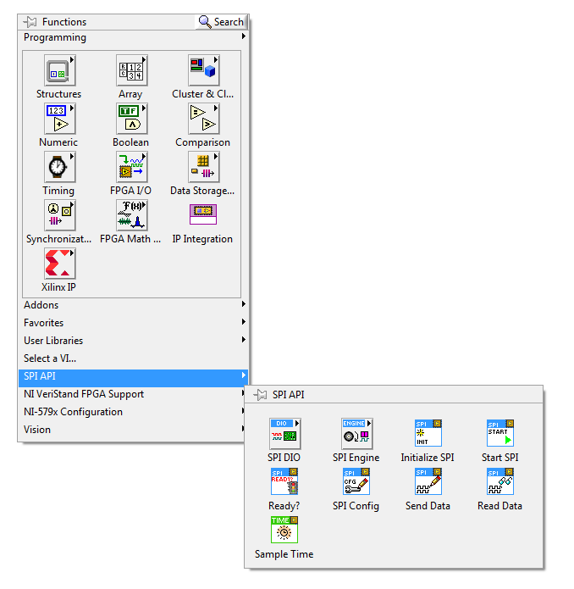
SPI API Palette
Notes:
Once you have downloaded and installed the SPI API, you will have a new item added to the FPGA palette. Open a blank FPGA VI, and right click to see the API shown here. All of the VIs necessary to interface with your SPI chip can be found here.
In order to help you understand the purpose of these VIs, I will show you a completed example and explain the parts of the code. To find this example first open NI Example Finder. From within LabVIEW click on Help>>Find Examples. The completed example demonstrates the use of the SPI API to control a simple Digital to Analog to converter. This example assumes that you have a MAX5216 plugged into PMOD1 on your NI 9651.

Slide 3
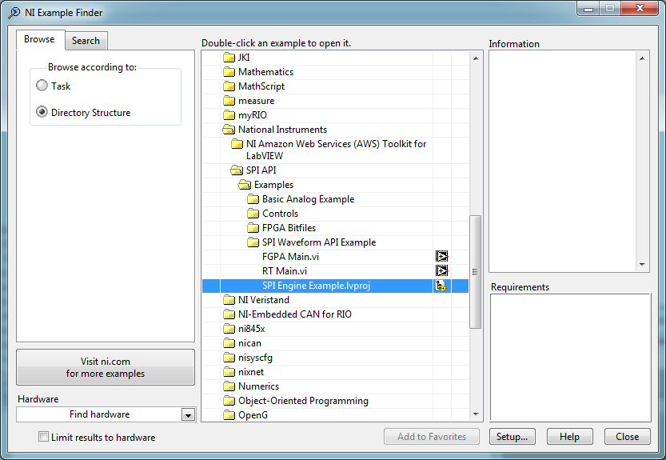
Example Finder
Notes:
Within NI Example finder, you will need to switch the Browse According to option to Directory Structure. Here locate the folder National Instruments and expand to find the subfolder SPI API. Click on the SPI Engine Example.lvproj to open the project I will be discussing.

Slide 4
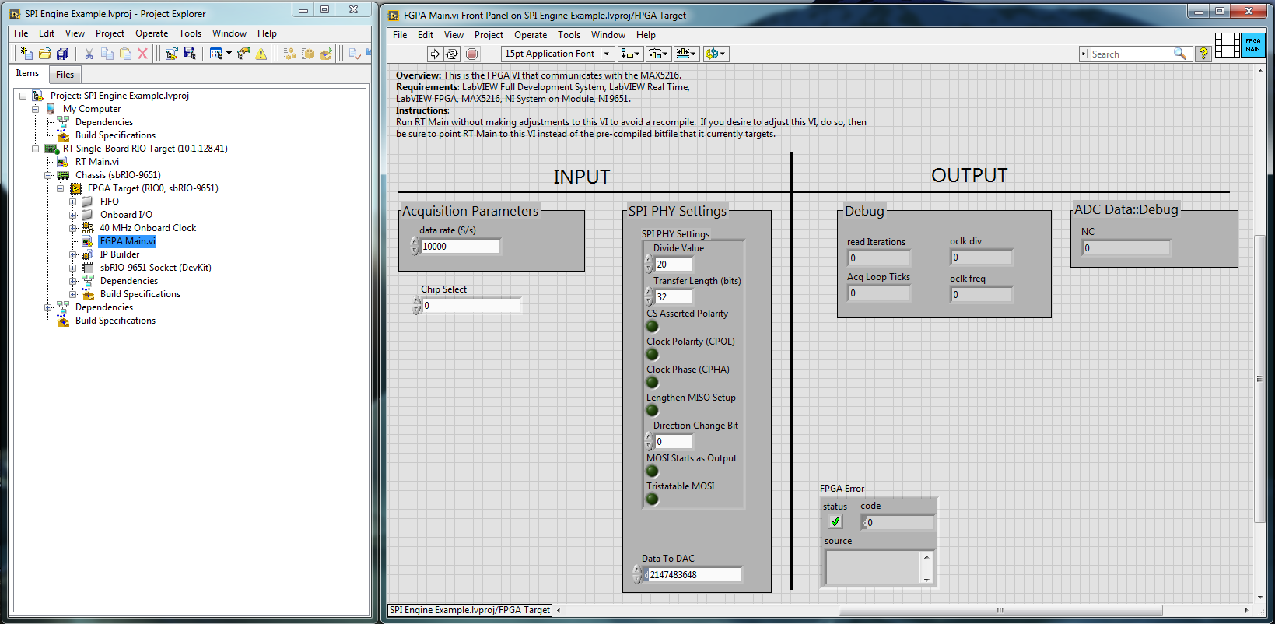
Example Project
Notes:
Once the project is open, locate FPGA Main.VI and open it. You should have something that looks like this image. I will begin by explaining the FPGA code used in this application.

Slide 5
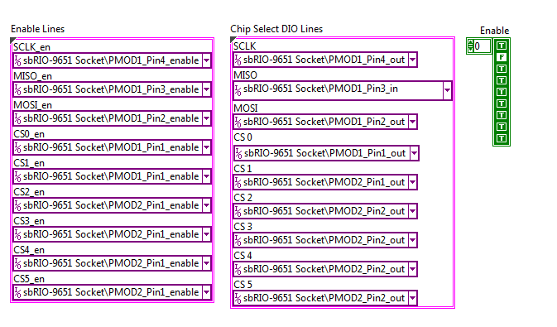
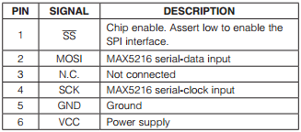
SPI Settings
Notes:
Navigate to the block diagram for FPGA Main.vi. Here you will notice the cluster constants shown above (note that in the program they are aligned vertically instead of horizontally). We need to populate these constants using the datasheet for the Digital to Analog converter. In this example we are specifically using the MAX5216 DAC.
Click: The PMOD connector diagram for this particular device can be seen here.
Click: Using this sheet we set the constants based on the signals that the lines will correspond to. We start with SCLK_en in the Enable Lines cluster, and set this to Pin4, as has been indicated by the SCK clock signal in the datasheet. Since our MAX5216 is plugged into PMOD1, I will choose PMOD1_Pin4_enable as the Enable Line.
Click: We do the same thing for the Chip Select DIO Line, and Enable Lines. Since the clock line will be an output pin on the FPGA, we set the Chip Select DIO Line to PMOD1_Pin4_out. The first element in the enable array must also be set to true to set this as an output.
Click: Contine for the other elements. Notice that the only line that is an input in this case is MISO. This line must be set to PMOD1_Pin3_in, and the Enable array must be set to False in order for this to be configured as an input. This particular device is an output only device, and as such MISO is set to No Connect. We setup this line only for demonstration purposes in this case.

Slide 6
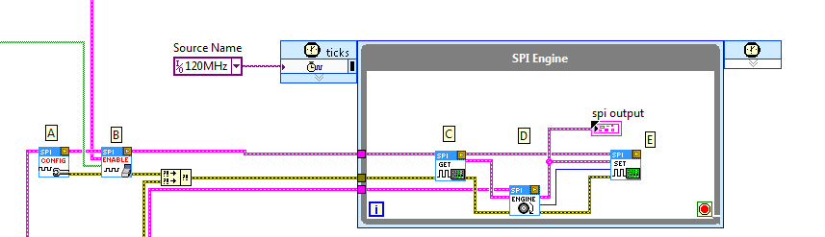
SPI Engine
Notes:
Once these constants have been defined, the rest of the FPGA code is already setup. For sake of demonstration we will discuss the other parts of the code here. VIs A and B in the code here will configure the SPI session using the constants we just defined. Once the session has been defined, the Timed Loop will begin executing the SPI Engine. The SPI Engine consists of three Basic Steps labeled C, D, and E. In step C, SPI Data is read from the MSIO line. In step D, the SPI Engine communication executes. This sets up the commands and returns data from the user loop. Step E then transmits the next bit of data out on the MOSI line.

Slide 7
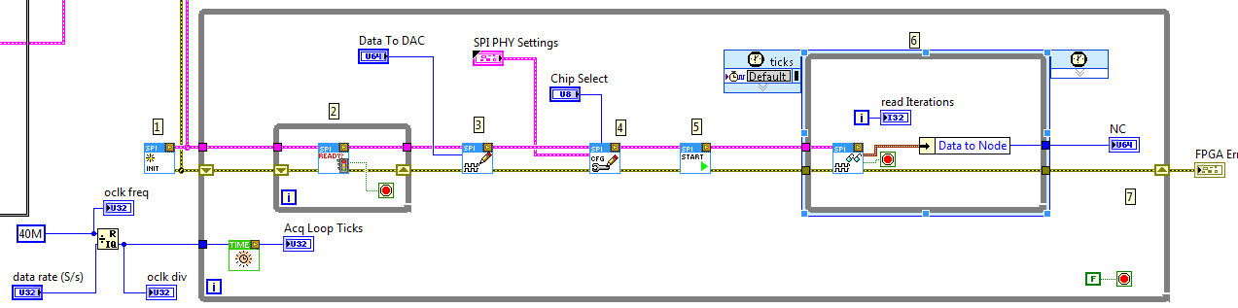
SPI Write Loop
Notes:
This second parallel loop is where the SPI commands will be configured and sent to the SPI Engine for processing. Similar to the last slide, these steps are labelled 1 – 7. In step 1, the FPGA resources used for transmitting data between the Write Loop and the Timed loop are setup. Then, inside our while loop we have step 2. Here we will continuously loop until the SPI Engine indicates that it is ready for the next command to be sent. Without this our code could potentially override commands in the buffer before they are sent out over the SPI bus.
Step 3 pulls in the pre-formatted command that will be sent out to the Digital to Analog SPI chip.
In step 4 settings specific to this transmission are applied. These settings are explained in more detail later. For now, take note that this allows you to select which chip and at what data rate this particular command is to be sent.
Step 5 will tell the SPI engine that the current command is now ready for transmission. The SPI engine will transmit this data over the SPI bus.
Step 6 will loop until data has been returned from the SPI engine indicating that the command was properly sent. If the command was to be followed by return data from the SPI chip, the Data to Node output will contain that data.
Step 7 writes the return data to a front panel control. That front panel control will be read in our real time code.

Slide 8
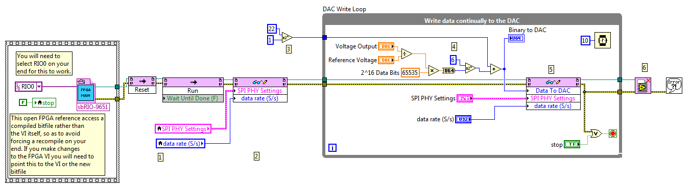
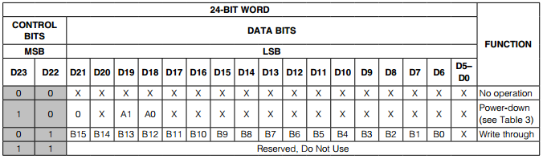
Real Time Main
Notes:
At this point, close FPGA Main.vi and open RT Main.vi. This code runs on the real time processor and transmits settings and commands to the FPGA. This code is setup to run the pre-compiled bitfile that installs along with the examples. You can set it to run another bitfile is you would prefer.
Step one of this VI resets the FPGA code, and runs it again, such that all controls should be in their default state.
Step 2 takes the settings from the front panel of RT Main and transmits those settings to the FPGA.
Click: Step 3 begins to form the packet of data that will be send to the SPI chip based on the Truth Table from the datasheet shown here.
Click: Each write command for this Digital to Analog Converter must have a 1 in the 22nd bit position. Step 4 takes the Voltage Output control from the front panel and converts this to a representation that the SPI chip will recognize based on a formula provided in the datasheet.
Click: This data must then be bit shifted by 6 bits since the last 6 bits of the data packet sent to the controller are not used.
Step 5 will then write this data to the FPGA. Here the other settings are re-sent to the controller, allowing the user to change them at will during runtime.
Step 6 simply closes the current FPGA reference.

Slide 9
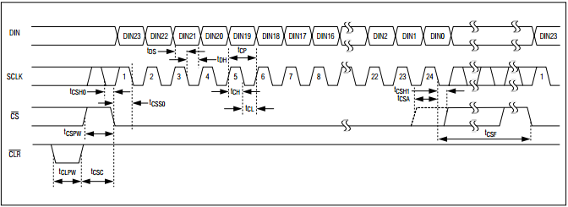
SPI PHY Settings
Notes:
Lastly we must configure the settings that are specific to each transaction on the SPI bus. These settings will tell the SPI Engine how to configure the outgoing waveform.
We can understand these settings by looking at the command waveform shown in the datasheet.
Click: We can see here that the Digital input is read into the SPI chip on the rising edge of the clock signal. This tells us that the clock is not inverse polarity. We can also see that the transmission length of a packet is 24 bits.
Click:

Slide 10
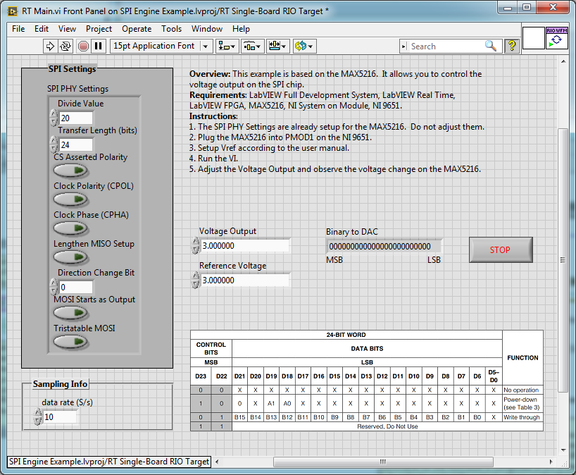
SPI PHY Settings
Notes:
We take those settings and place them into the SPI PHY Settings control on the front panel of this VI.
This example is now ready to run. While it is running, change the voltage output on the front panel, and the corresponding voltage will change on the output pin of the SPI chip.

